Slide 1

BDD/TDD
BDD/Desarrollo dirigido por Comportamiento
Notes:
‹#›

Slide 2
TDD

Slide 3
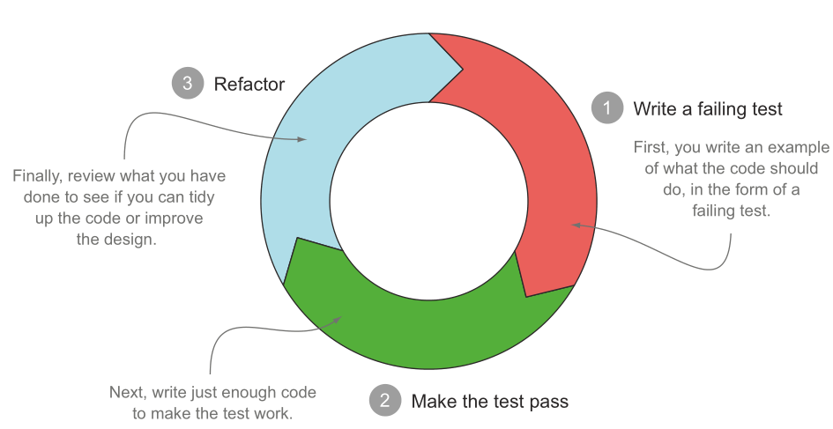
Siglas
BDD: Behavior Driven Development
TDD: Test Driven Development
DDD: Domain Driven Design
1

Slide 4
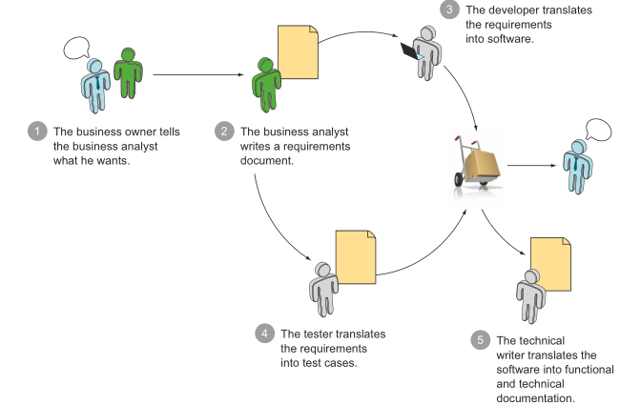

BDD
Tradicional:
BDD in Action: Behavior-Driven Development for the Whole Software Lifecycle, John Ferguson Smart

Slide 5
BDD

Slide 6
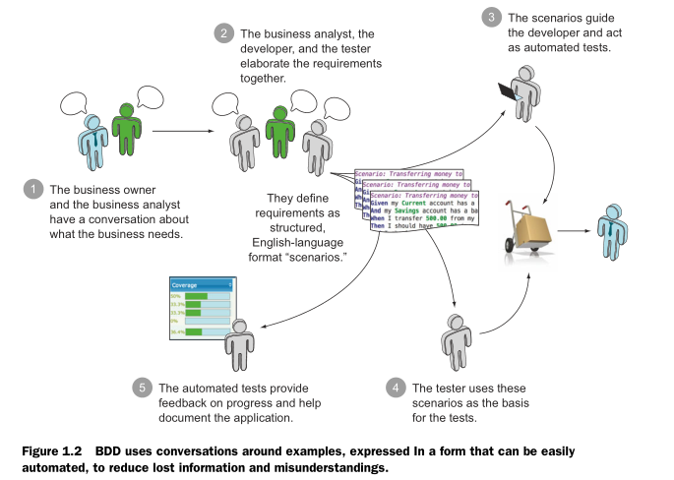
Conversaciones BDD
BDD

Slide 7
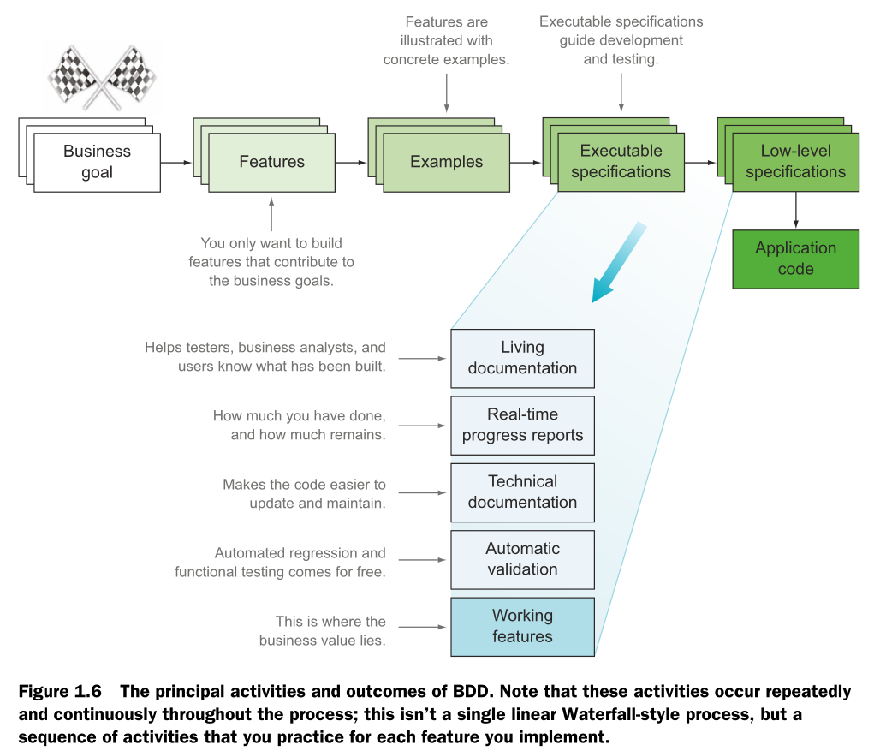

Slide 8
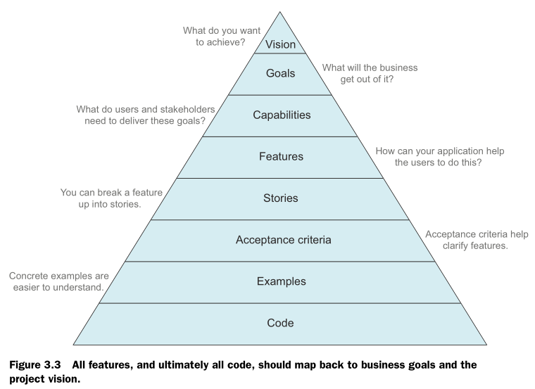
BDD
Ayuda a focalizar esfuerzos en lograr capacidades que cumplan las necesidades de la organización

Slide 9
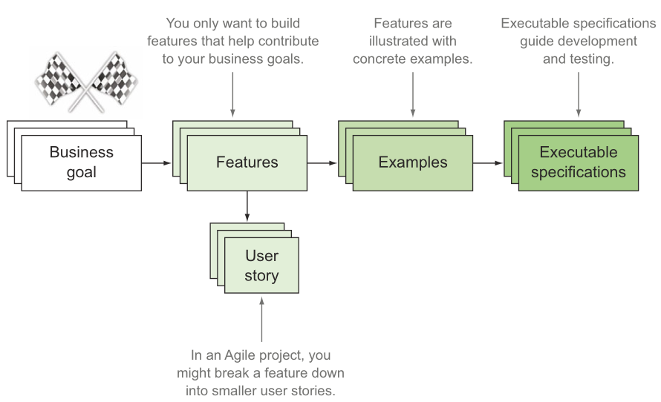
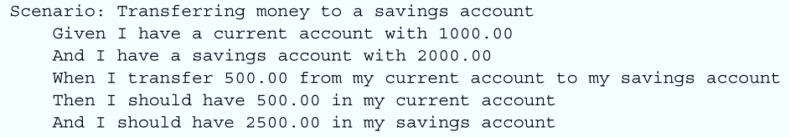
DON’T WRITE AUTOMATED TESTS, WRITE EXECUTABLE SPECIFICATIONS

Slide 10
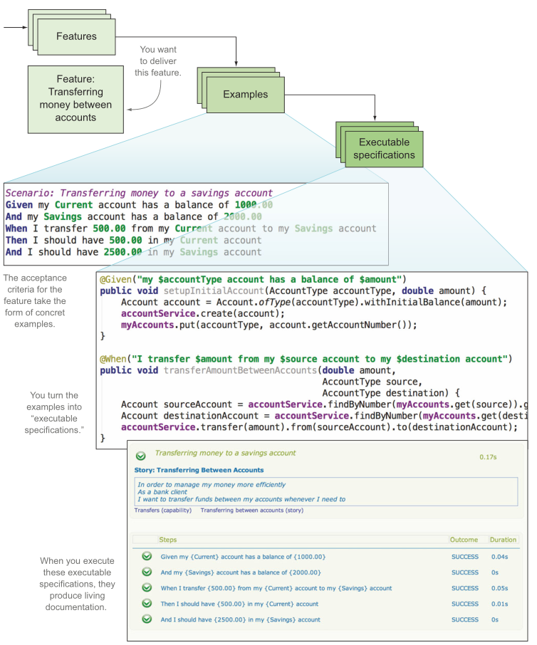
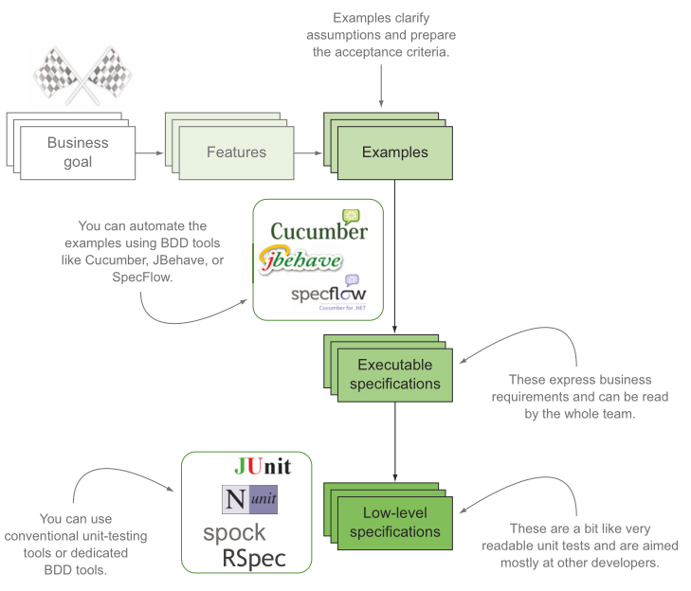

Slide 11
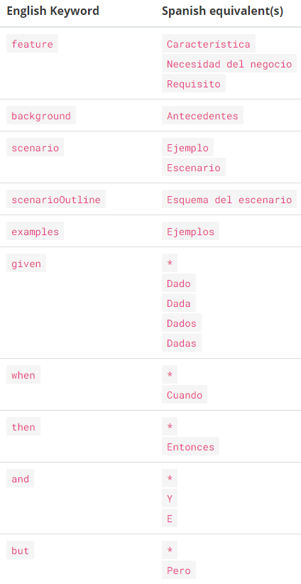
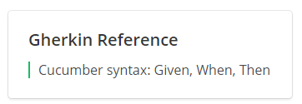
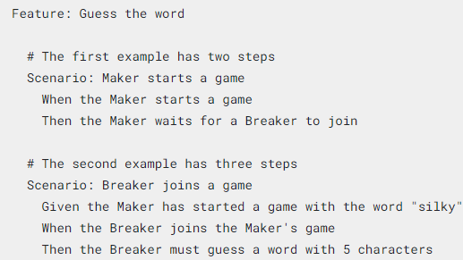
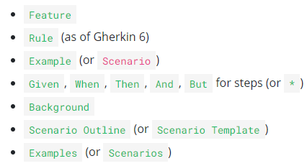
Gherkin
Given, When, Then
https://cucumber.io/docs/gherkin/reference/

Slide 12
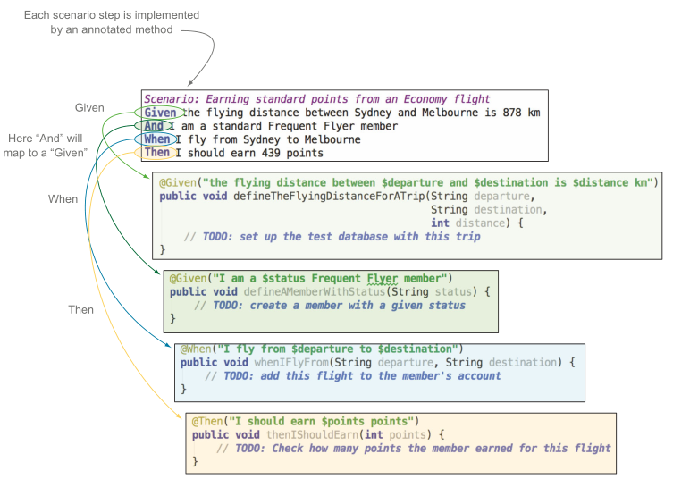
Cucumber / JBehave

Slide 13
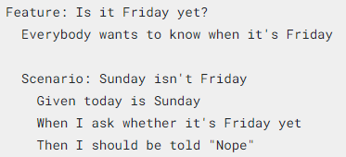
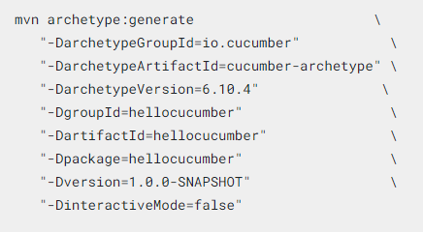
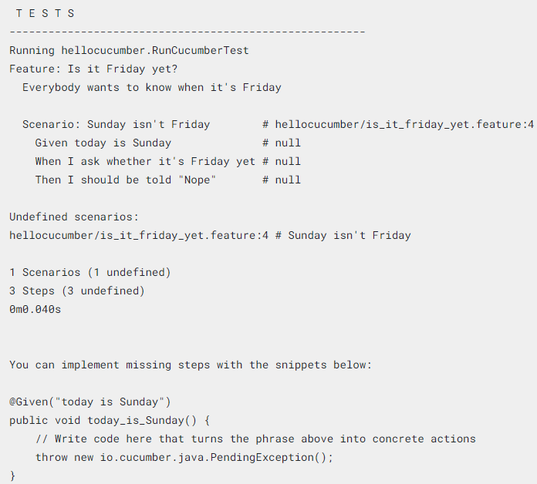
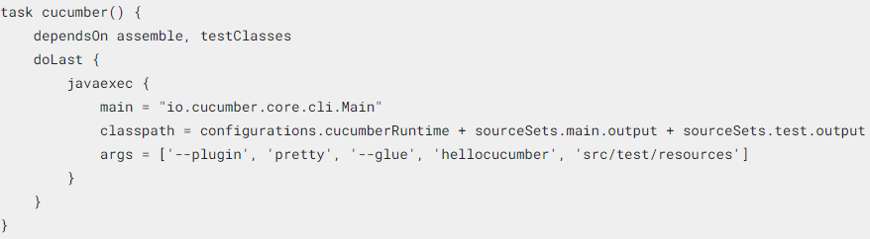
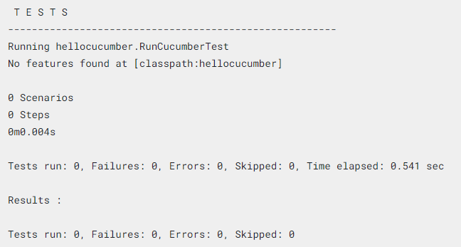

Cucumber

Slide 14
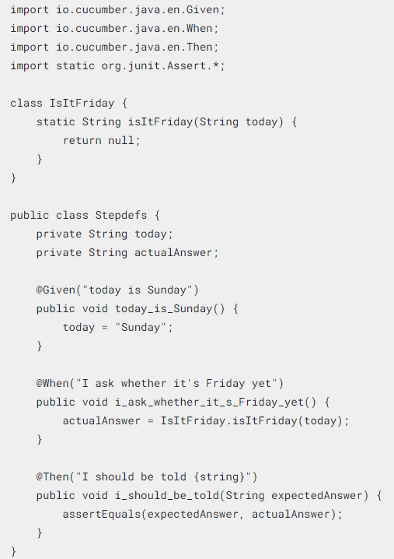
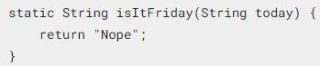
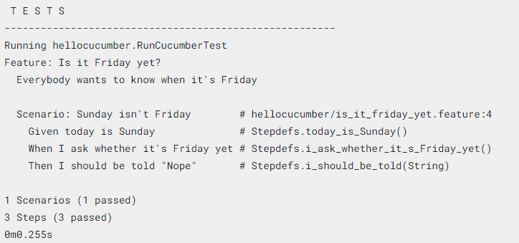

Slide 15
Pruebas Automatizadas

Slide 16
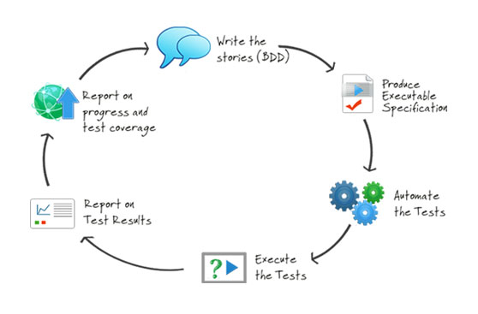
Serenity BDD

Slide 17
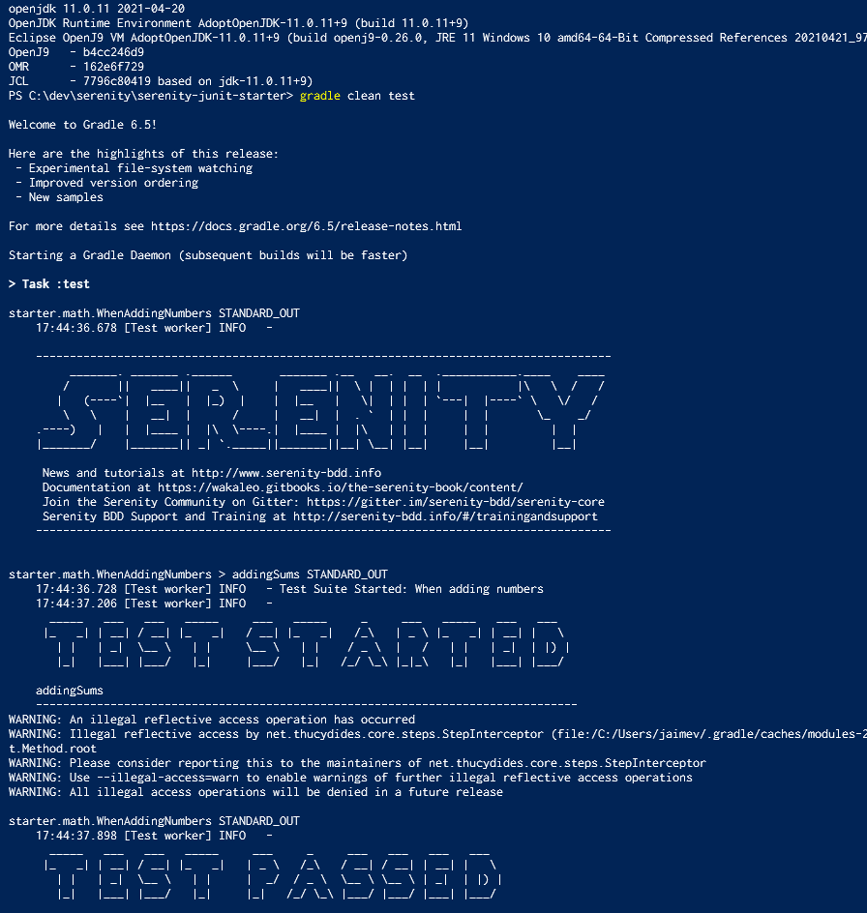
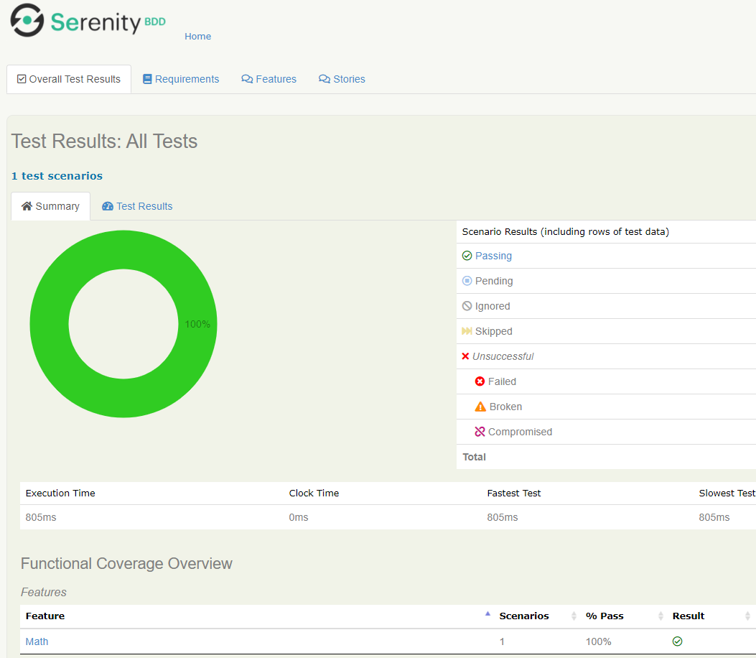
Serenity

Slide 18
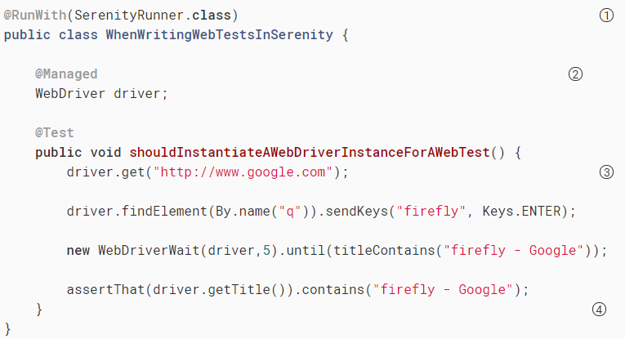
Web Testing
Ejemplo, simple

Slide 19





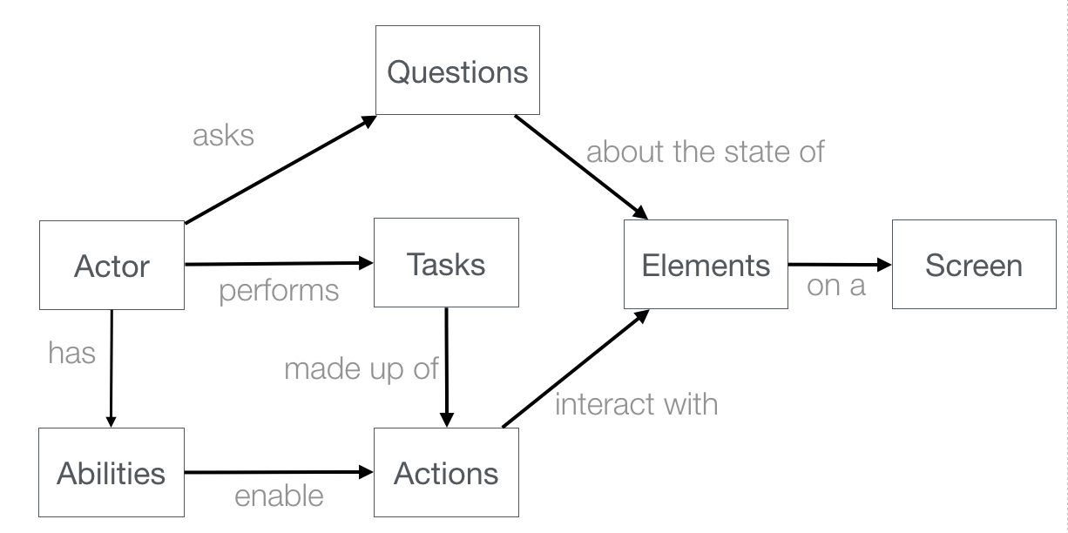
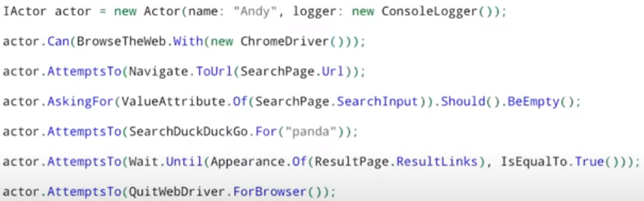
Screenplay
Web
elements
Actor
Habilidad
Interacción
Web
Actores usan habilidades para ejecutar interaciones

Slide 20
Patrón Screenplay y pruebas con Serenity
The Screenplay Pattern is a user-centred approach to writing high-quality automated acceptance tests. It steers you towards an effective use of layers of abstraction, helps your tests capture the business vernacular, and encourages good testing and software engineering habits.
Instead of focusing on low-level, interface-centric interactions, you describe your test scenarios in a similar way you'd describe them to a human being - an actor in Screenplay-speak. You write simple, readable and highly-reusable code that instructs the actors what activities to perform and what things to check. The domain-specific test language you create is used to express screenplays - the activities for the actors to perform in a given test scenario

Slide 21
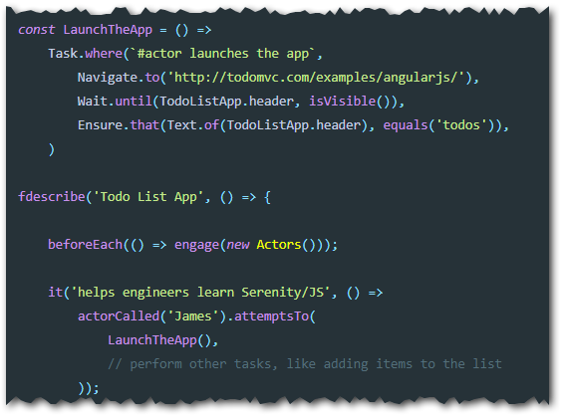
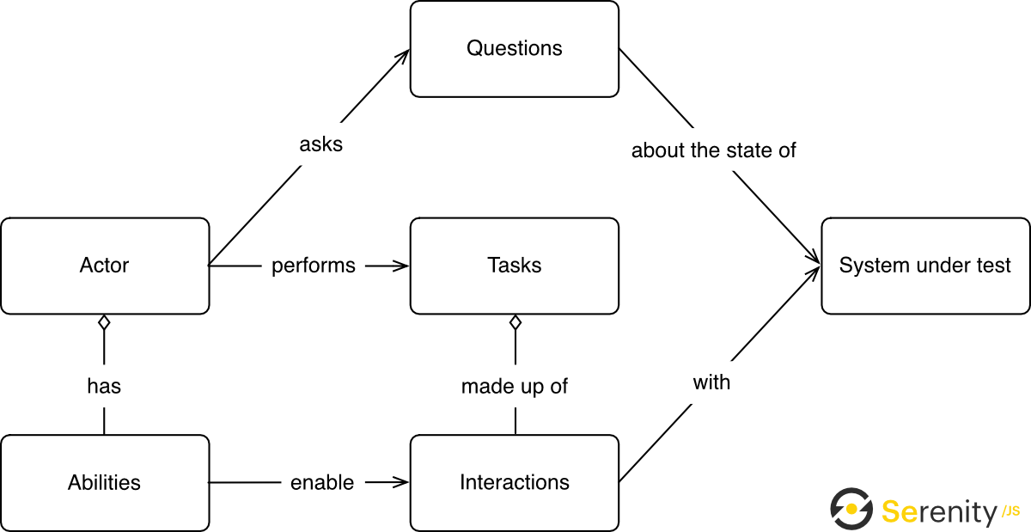
Elementos de Screenplay

Slide 22


API
VCSOFT Argentina S.A.
Luis María Campos 134 10°
Tel.: (54-11) 5258 2374
Cel:(54 9 11) 3236 9775
Buenos Aires, Argentina
VCSOFT S.A.S.
Calle 100 No 17A - 36 Of. 601
Tel: (57-1) 621 9348
Cel: 315 343 3919
Bogotá, Colombia
VCSOFT Chile S.A.
Francisco Antonio Encina 1781
Tel: (56-2) 28171983
Cel:(56-9) 6288 5114
Santiago, Chile

